Slide 1
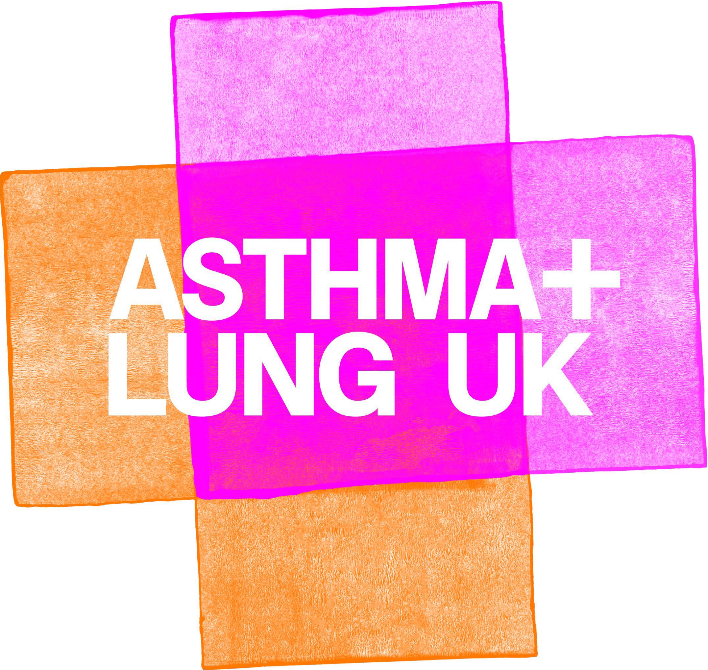


Slide 2

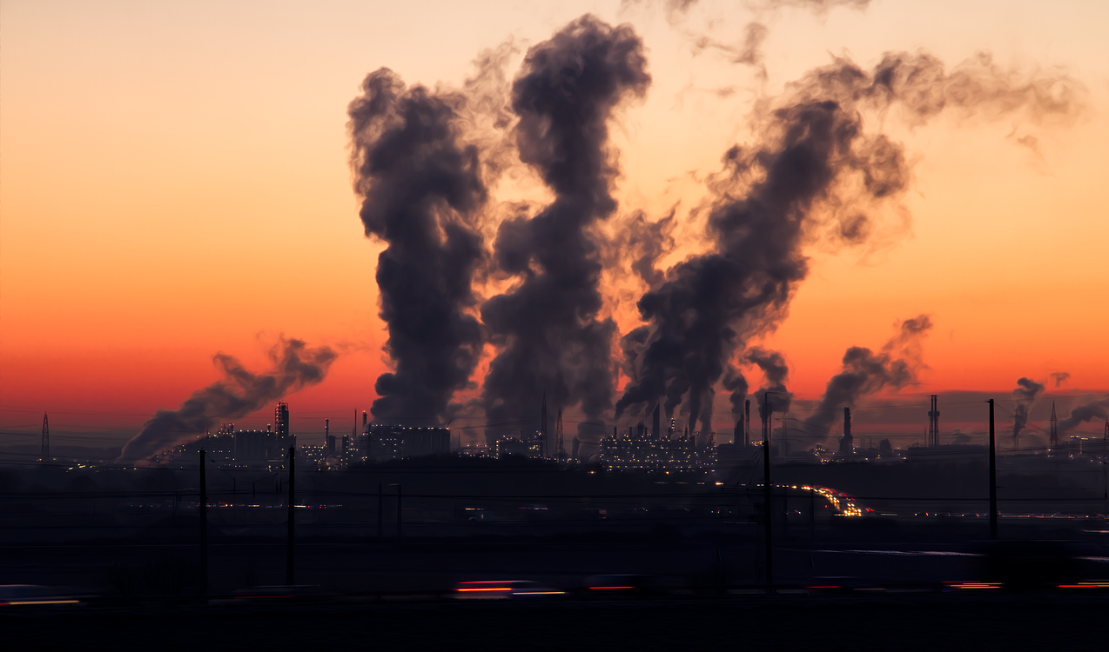
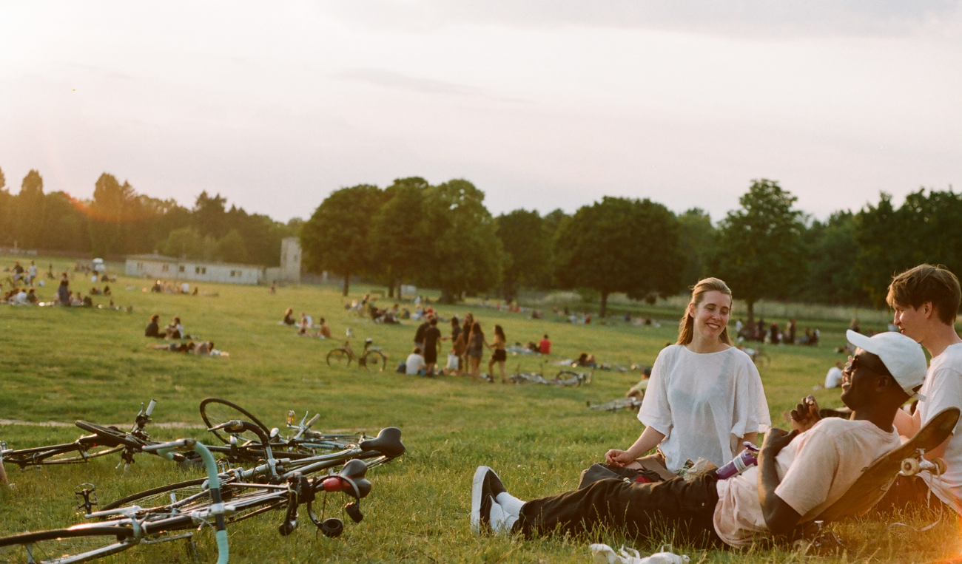
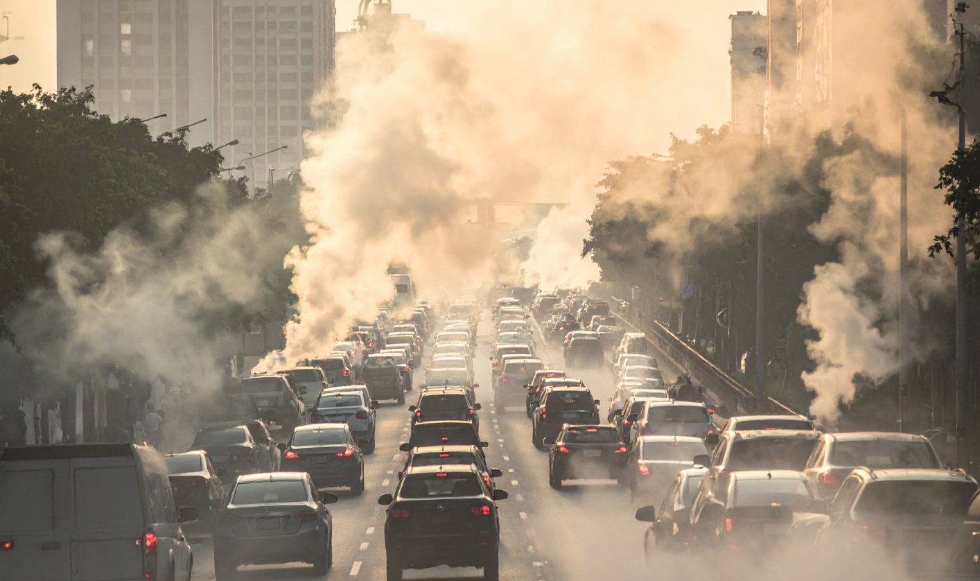

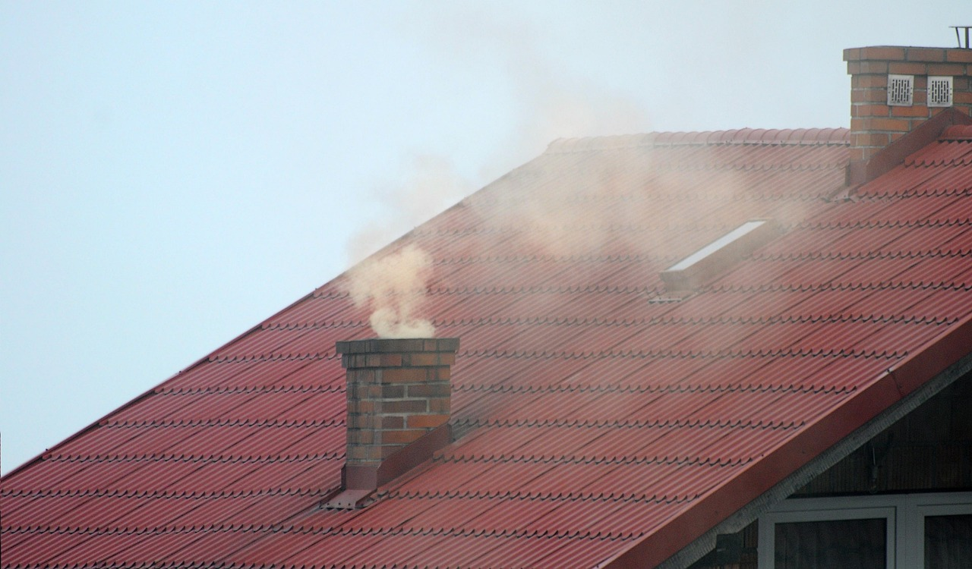
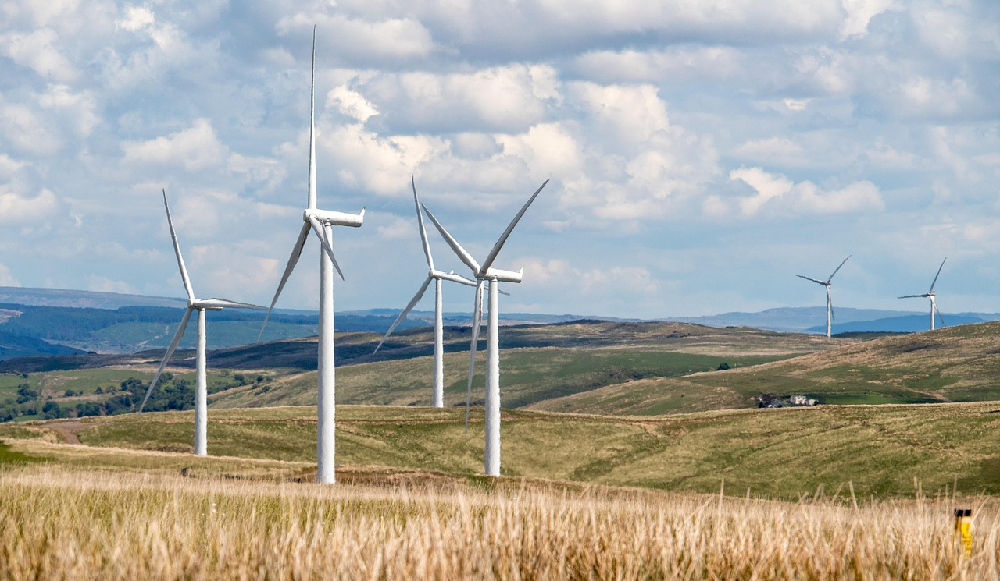
What Do You See?
What differences do you see between the pictures?​
What do you think is happening in the 'polluted' pictures?​
Where do you think these pictures could have been taken?

Slide 3
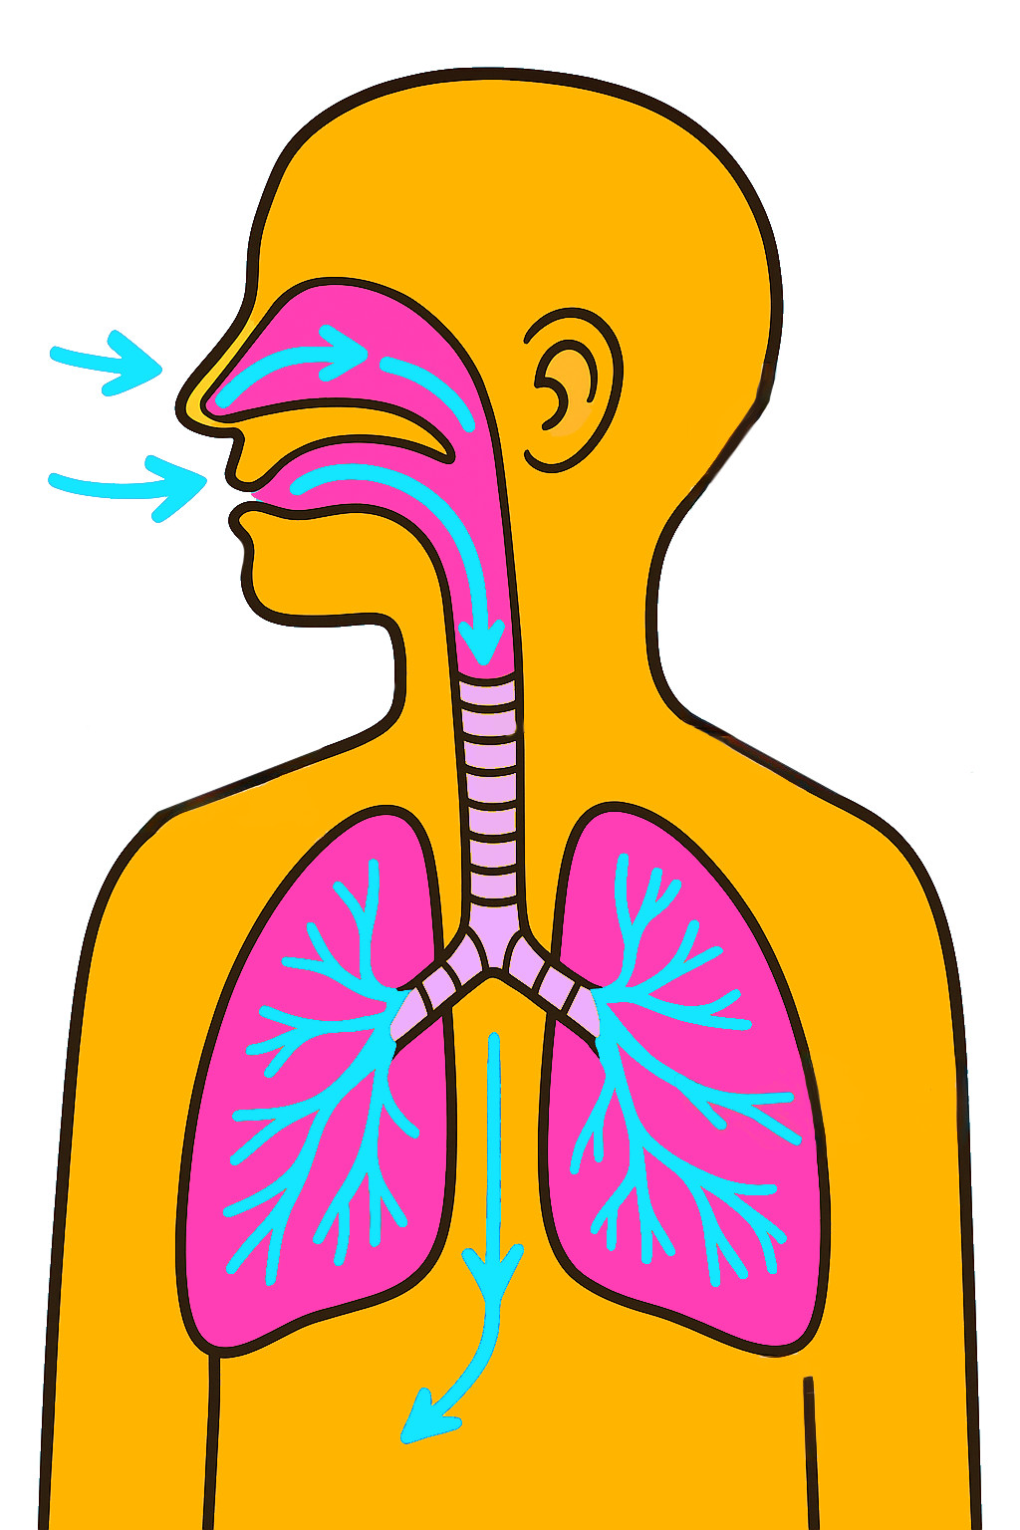
The Problem with Pollution
Have you ever thought about what's in the air you breathe?​
​
What could cause air pollution?

Slide 4
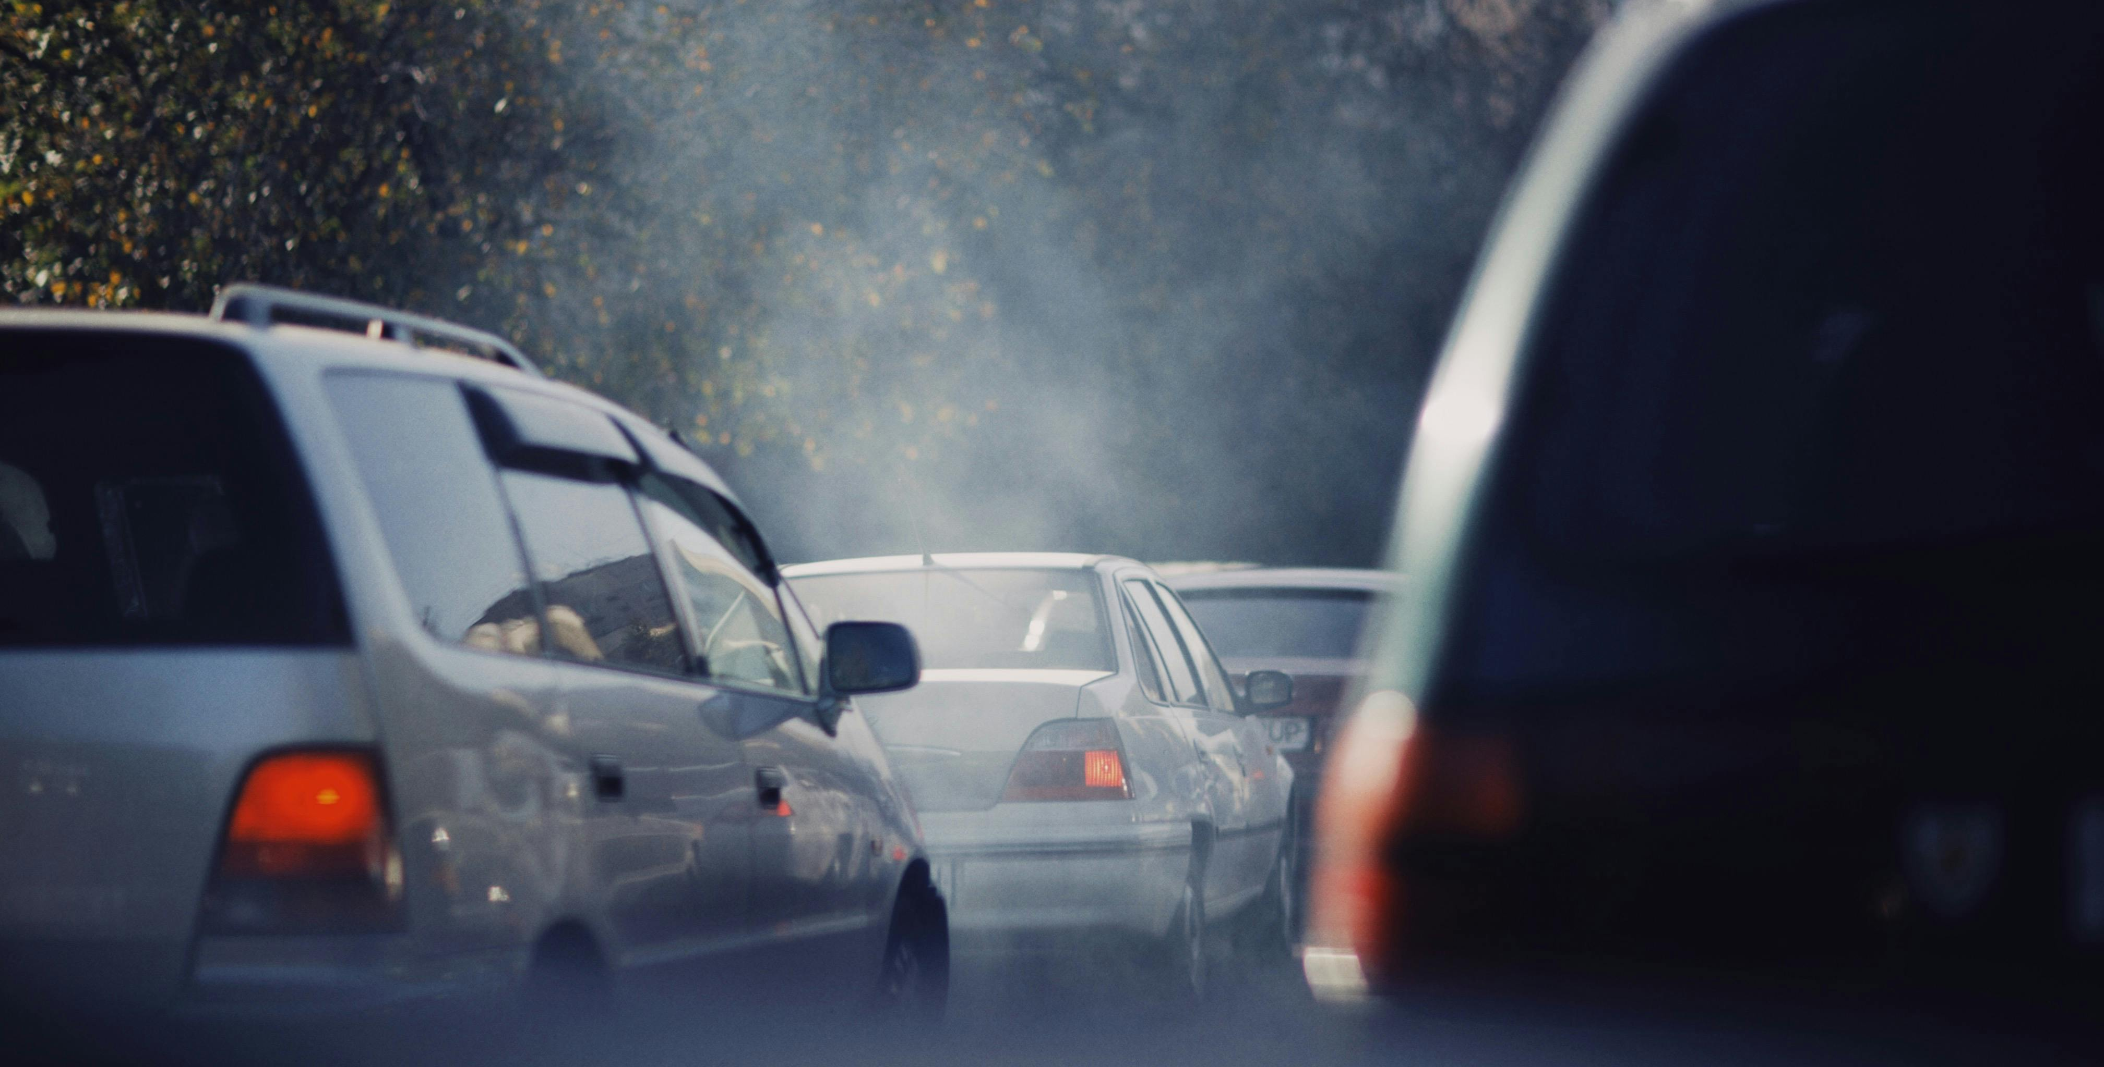
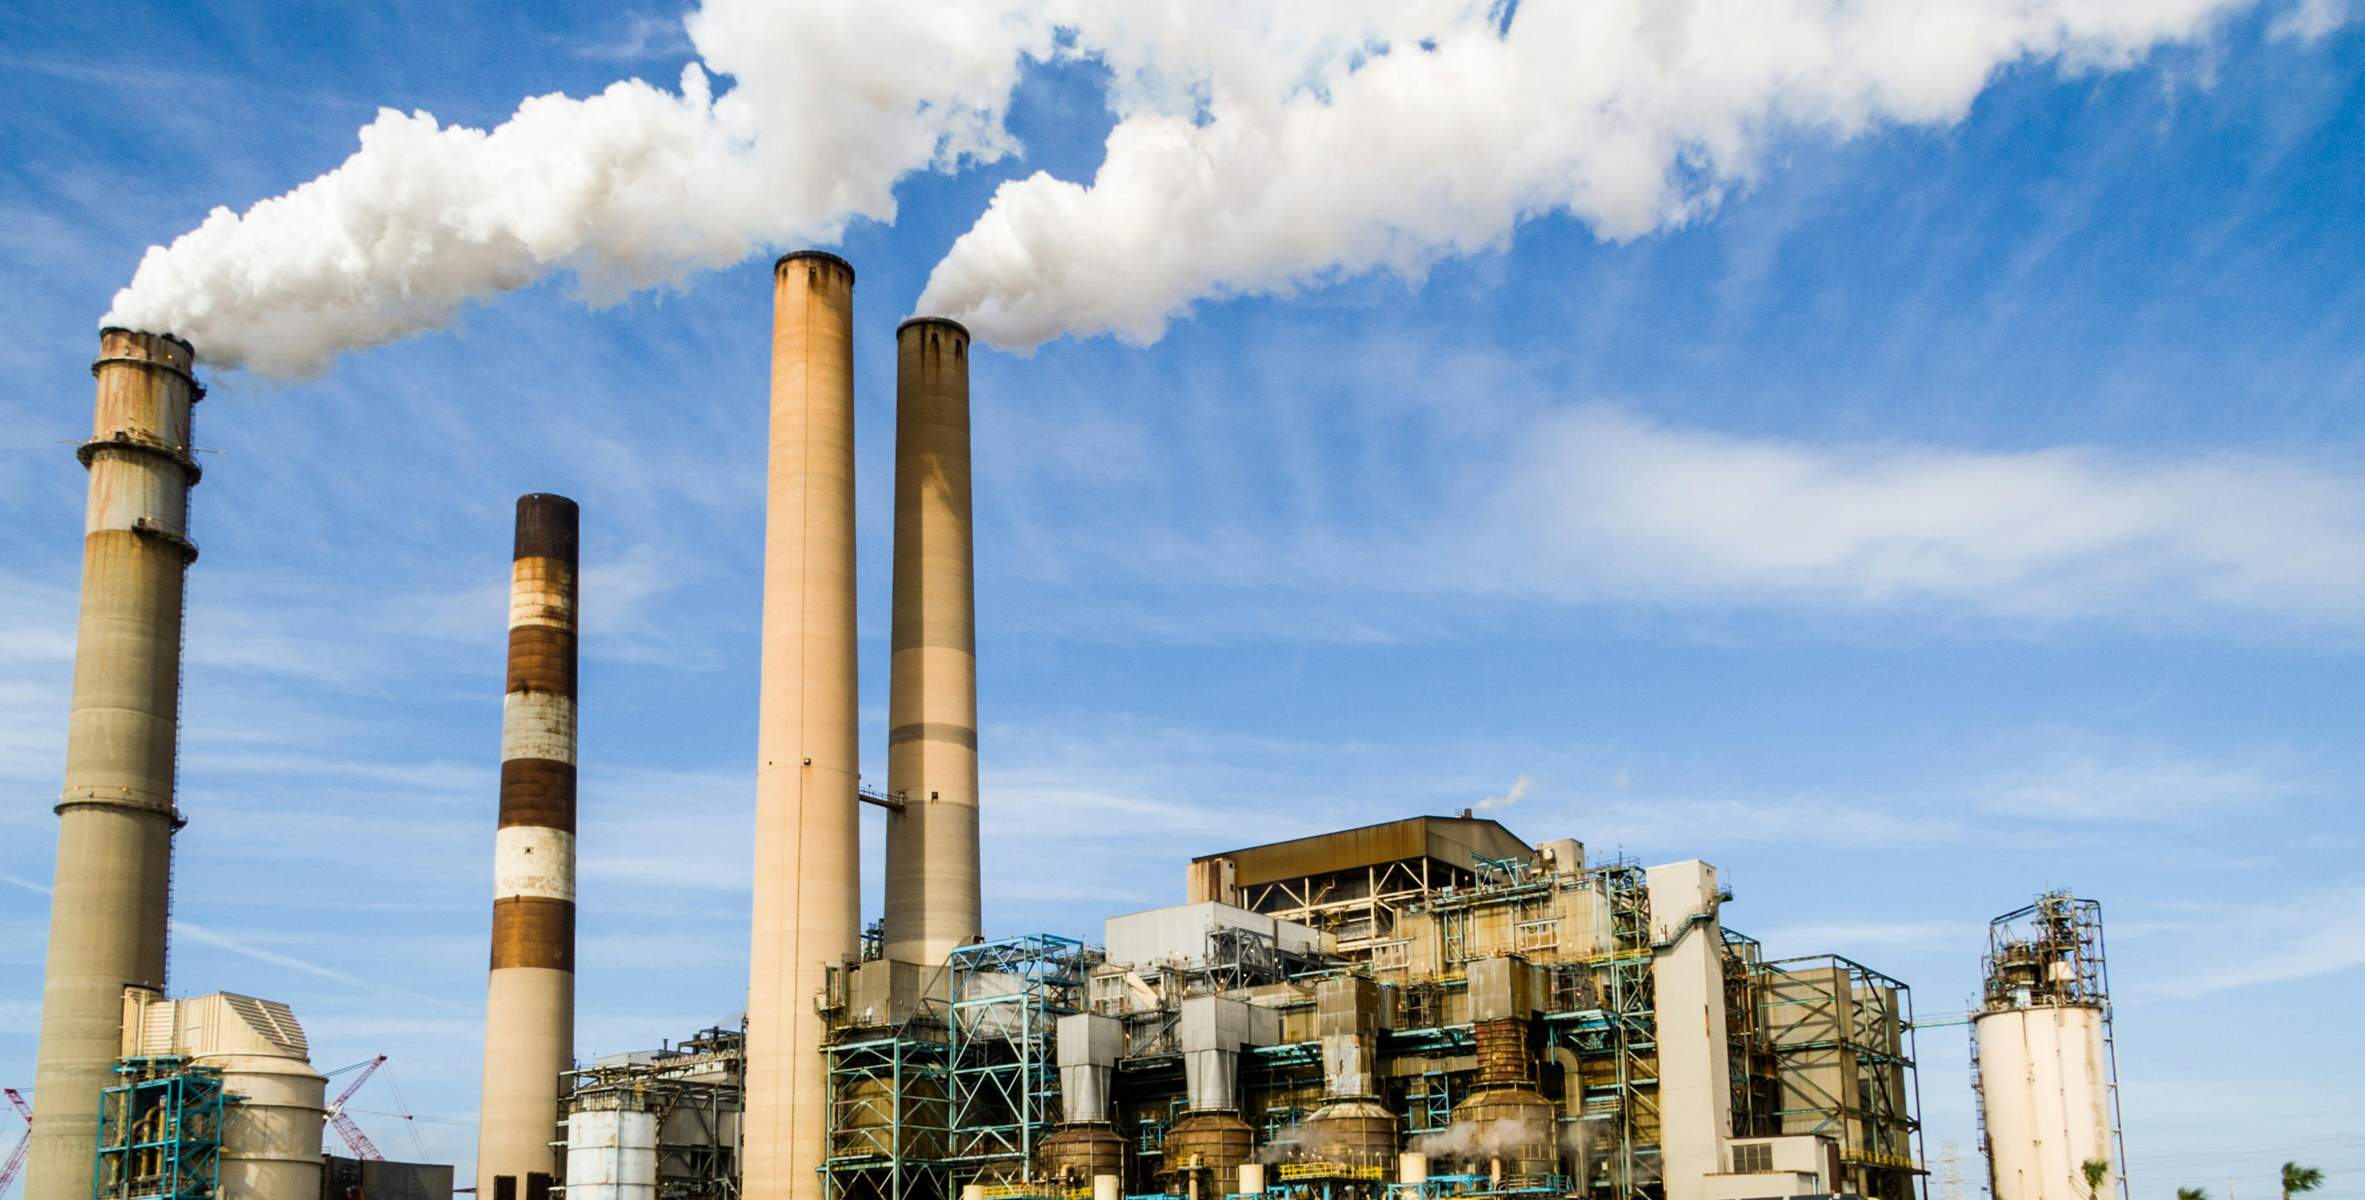
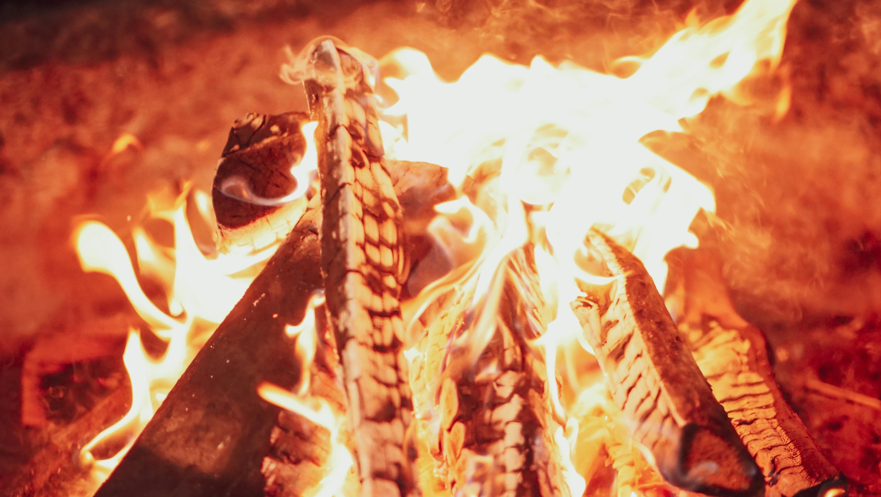
Polluted Air
Air pollution (or dirty air) is caused by the introduction of harmful gases and particles in the atmosphere. ​
​
Some main causes are:
Emissions from motor vehicles
Factories, power plants and construction sites
Wood or coal fires in homes
One main issue around schools is car idling. This is when vehicles are not moving but still have their engines running, meaning emissions pollute the air.

Slide 5
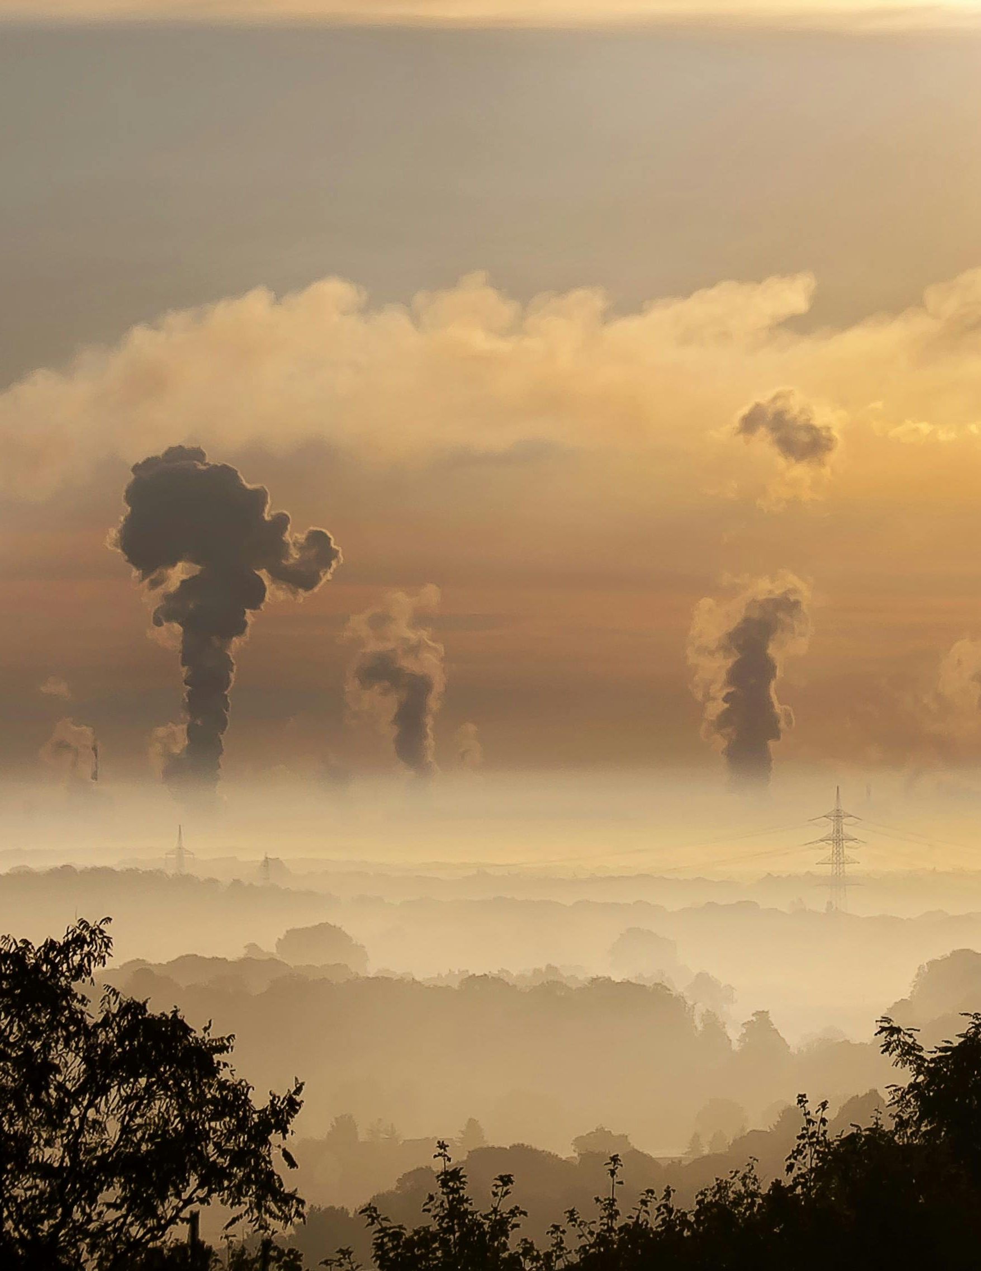
The Effects of Dirty Air
Dirty air harms us all but can be particularly harmful for people with lung conditions. Children and young people are also at a higher risk, as their organs are still growing and developing, and they breathe faster and more often per minute than adults. ​
​
Exposure to toxic air over a long period of time can cause lung conditions like asthma and COPD and can increase the risk of bronchitis and pneumonia.

Slide 6


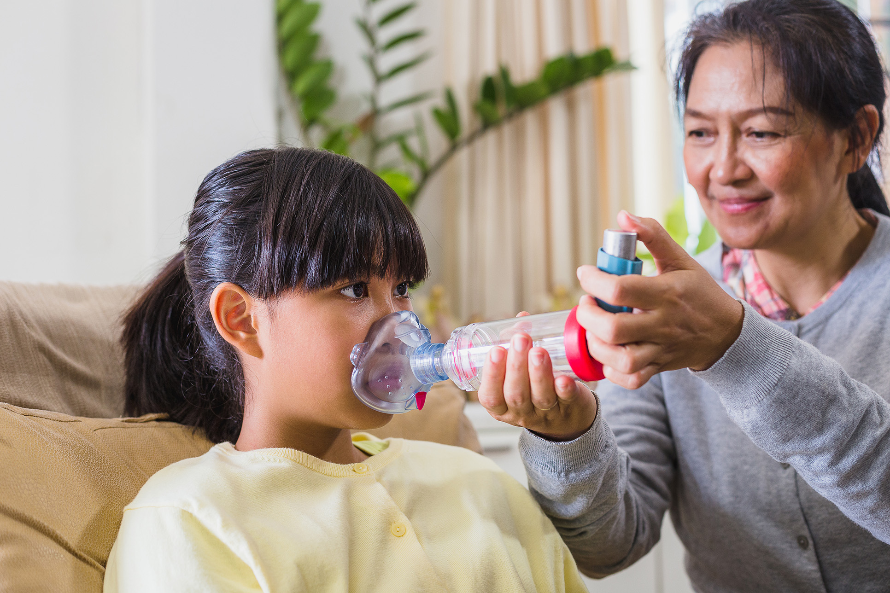
Signs and Symptoms
Yourself or others
Yourself or others having
coughing more
difficulty breathing
Pollution affects us in different ways, you might notice: ​
People with asthma
You are feeling breathless
Irritation in your
using their inhaler more
when doing outdoor activities
nose and throat

Slide 7

The People vs Pollution
Car idling should be made
illegal outside of schools

Slide 8
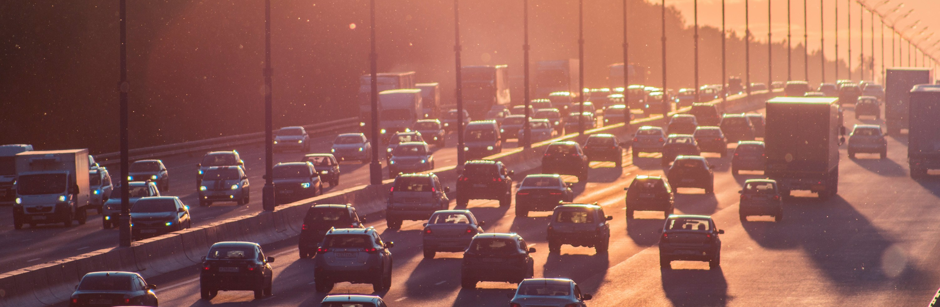
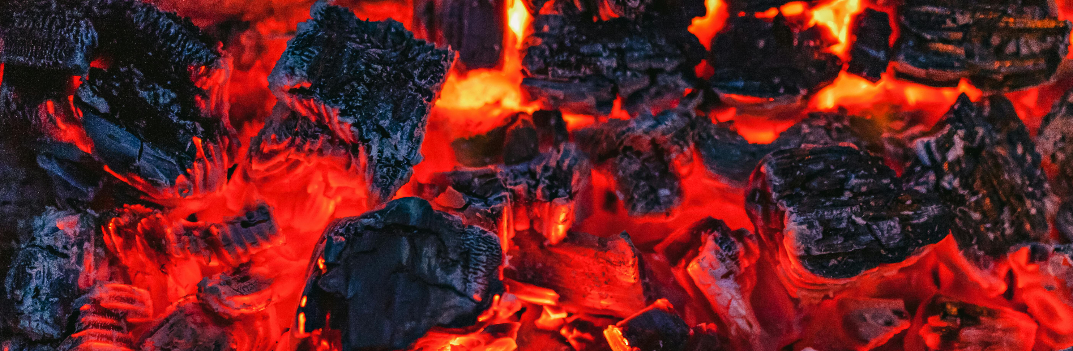
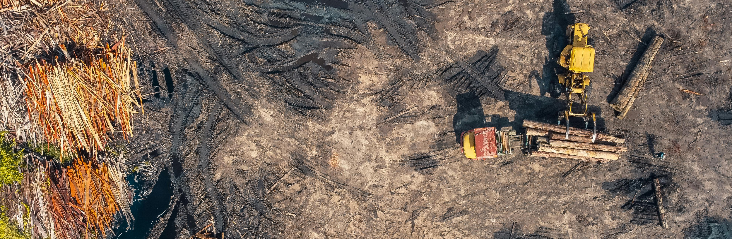
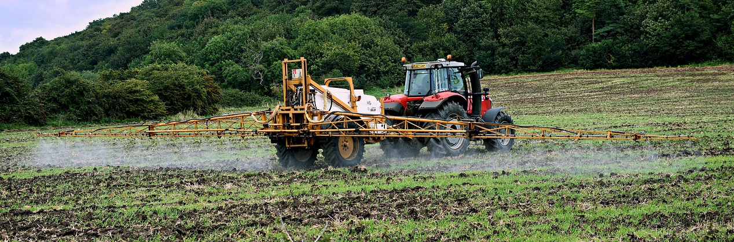
Pollution Solutions
What are some realistic solutions we can come up with to improve the air quality in our environment?

Slide 9
Play Your Part!
Asthma + Lung UK is campaigning for cleaner air. ​
​
We can all try and help the quality of the air we breathe by:​
Making use of public trains and buses whenever we can. ​
Walking or cycling instead of driving. This helps keep us active as well as cut down air pollution. ​
Switching off the engine when not moving, reducing the amount of car idling. ​
Avoiding having open fires.

